Slide 1

Solar Power Generation Prediction Using Environmental Variables
A Regression Analysis Project
Group 5
January 2025

Slide 2
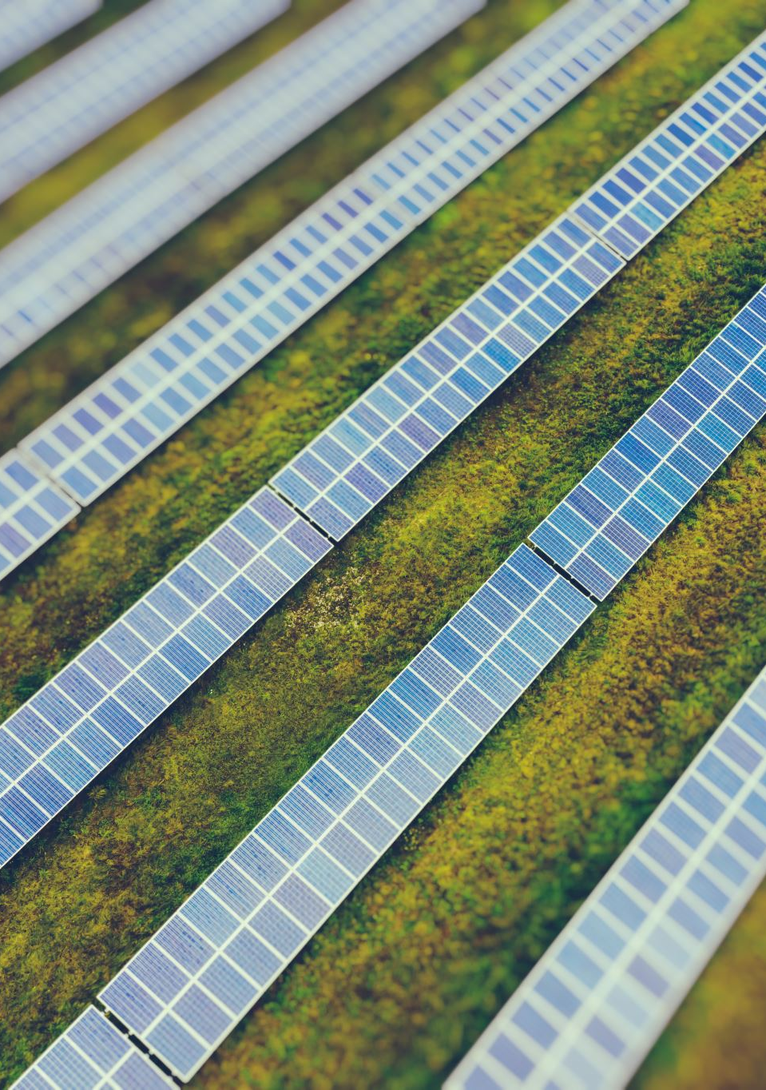

Objective
To model solar energy production as a function of environmental variables using regression techniques.

Slide 3
Dataset Overview
Dataset Name: solarpowergeneration.csv
Size: 2920 instances (rows) and 10 variables (columns)
Target Variable: power_generated (in Joules per 3 hours)
Features: Environmental variables such as temperature, wind speed, and humidity.

Slide 4
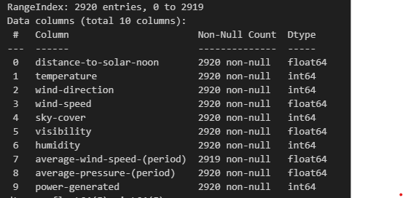

Slide 5
Features Description
1. distance_to_solar_noon: Radians
2. temperature: Degrees Celsius
3. wind_direction: Degrees (0-360)
4. wind_speed: Meters per second
5. sky_cover: Scale 0-4
6. visibility: Kilometers
7. humidity: Percentage
8. average_wind_speed: Meters per second
9. average_pressure: Mercury inches

Slide 6
Target Variable
Variable: power_generated
Unit: Joules
Measurement: Energy produced every 3 hours.

Slide 7
Regression Problem
Type of Analysis: Regression
Goal: Predict continuous values of power_generated.
Approach: Evaluate relationships between the target variable and independent features.

Slide 8
Data Preparation
Data Cleaning: Handle missing values, outliers.
Feature Scaling: Normalize or standardize variables.
Encoding: Convert categorical variables (if any) into numerical.
Splitting: Train-test split for model evaluation.

Slide 9
Exploratory Data Analysis (EDA)
Insights on feature correlations with power generated.
Visualizations:
Scatter plots
Heatmap of correlations
Histograms for variable distributions

Slide 10
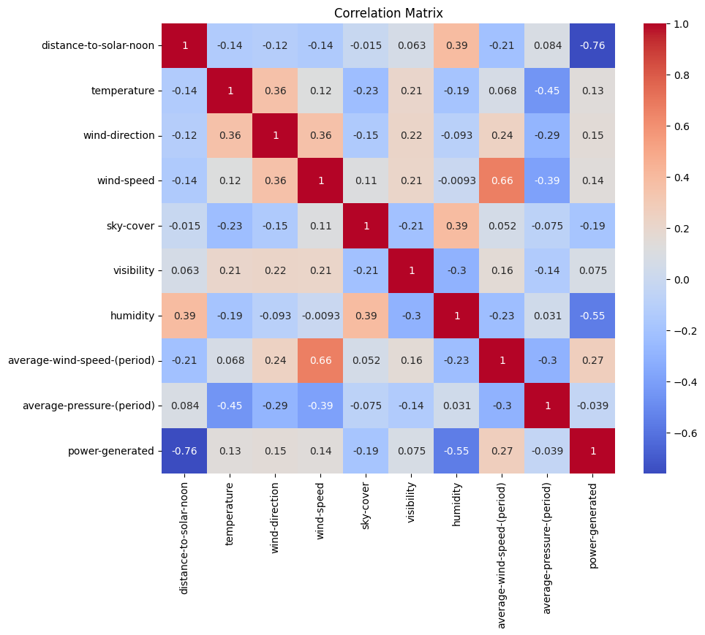
Correlation Matrix

Slide 11
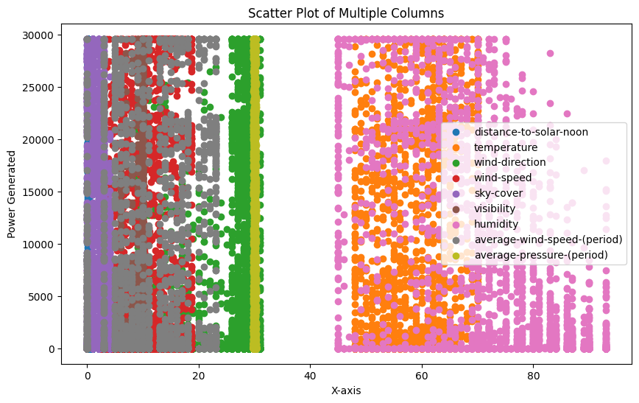
Scatter Plot

Slide 12
Modeling Approach
Models Considered:
LGBMRegressor
DecisionTreeRegressor
BaggingRegressor
RandomForestRegressor
GradientBoostingRegressor
AdaBoostRegressor
XGBRegressor
Evaluation Metrics:
Mean Absolute Error (MAE)
Mean Squared Error (MSE)
R-squared (R²)

Slide 13
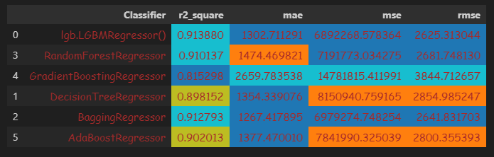
Models and Evaluation Metrics

Slide 14
Model Selection
Based on the results LGBM regressor is the best performing model.
So Stream lit deployment will be done with the same.

Slide 15
Deployment
Model was deployed using Stream lit
URL:
https://data-science-assignments-yfxyagxipbcmddp5rrxh9v.streamlit.app/

Slide 16
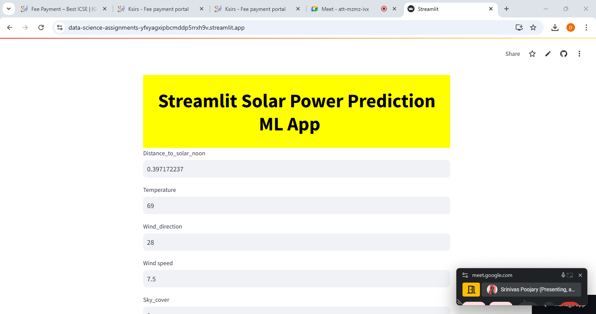

Slide 17
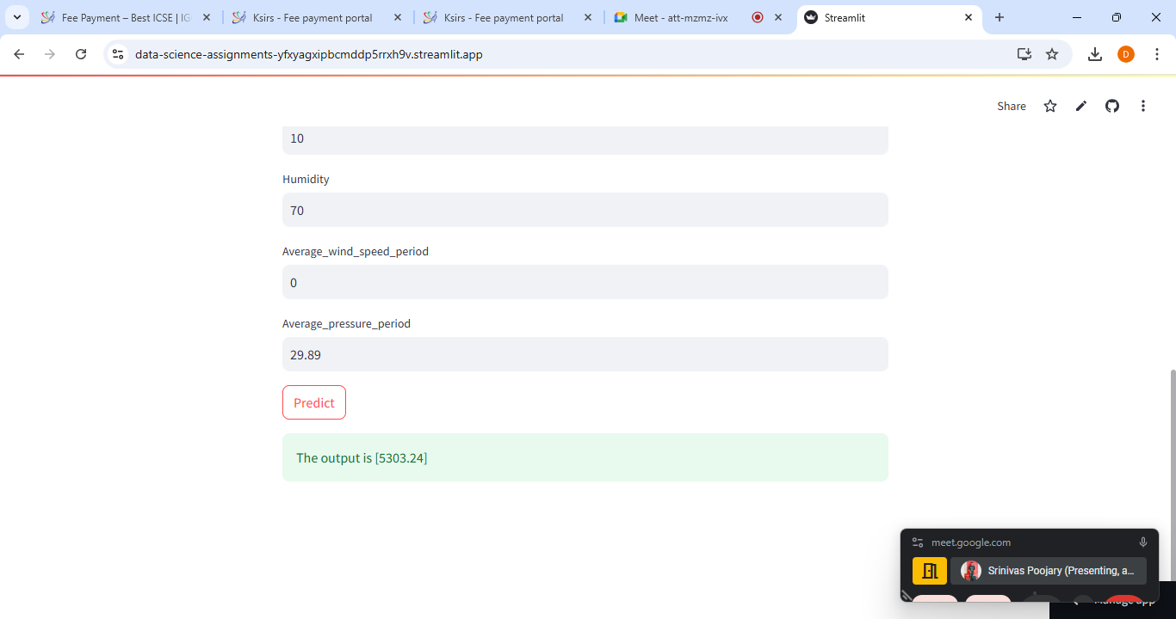

Slide 18
Future Work
Incorporate more granular data (e.g., hourly measures).
Explore advanced models like Neural Networks.
Investigate additional environmental factors.

Slide 19
Q & A

Slide 20
Thank you
Contributors
Ashritha
Eswar
Haritej
Hafiz
Preethi
Dhivya dharani

